Slide 1


Geometric Morphometrics and Archaeology
(Workshop One)
Dr Christian Steven Hoggard (University of Southampton)
CSHoggard
#StayHomeButStudy

Slide 2
Welcome!
Find the workshop materials https://github.com/CSHoggard/-workshopjapan2020
Stuck? Ask for help!
If you prefer: contact C.S.Hoggard@soton.ac.uk

Slide 3
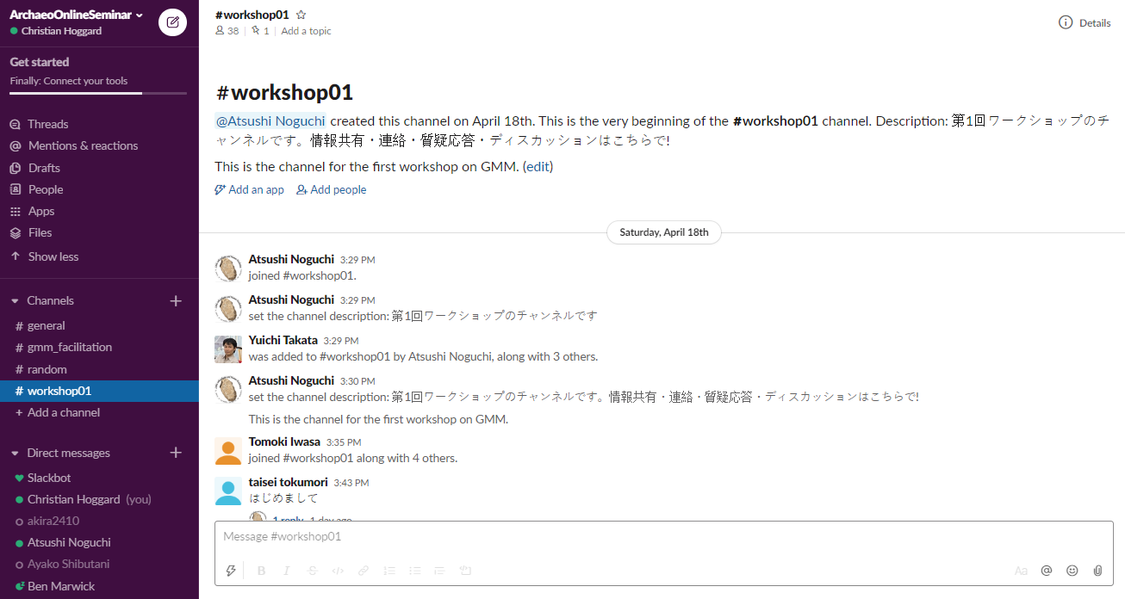

Slide 4
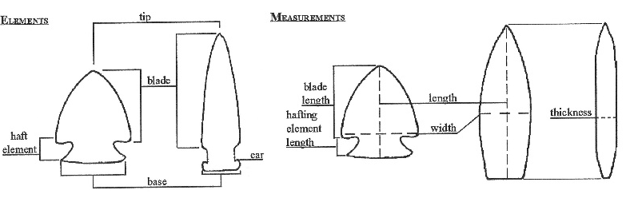
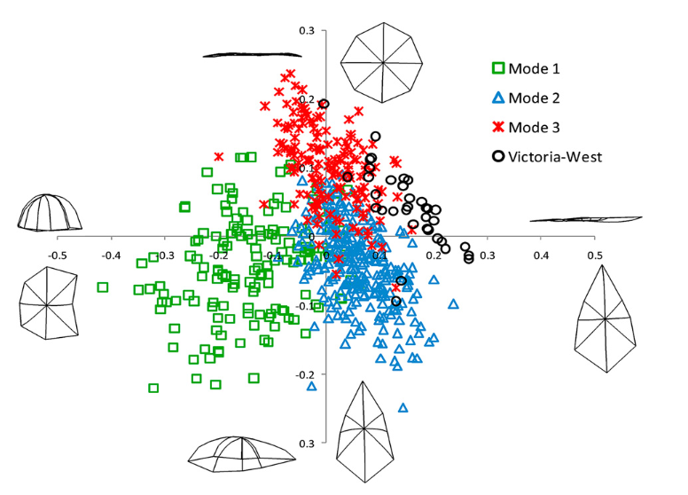
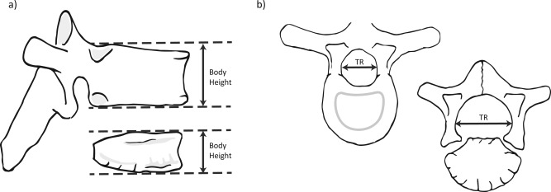

Slide 5
What is shape?

Slide 6
Shape as…
“In general terms, the shape of an object, dataset or image that can be defined as the total of all information is invariant under translation, rotation, and isotropic rescalings”
Small (1996: 6)
Small, C. (1996). The statistical theory of shape. New York: Springer.

Slide 7
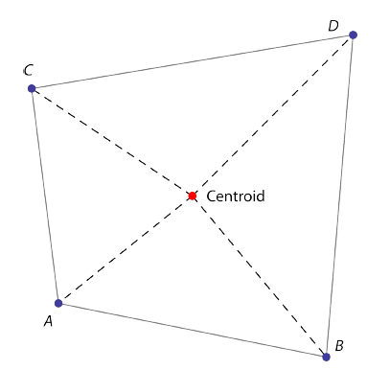

Size as…
The…
Length of an object?
Weight of an object?
Volume of an object?
Centroid size: square root of the summed squared lengths of the dashed lines
Mitteroecker, P., Gunz, P., Windhager, S., Schaefer, K. (2013). A brief review of shape, form, and allometry in geometric morphometrics, with applications to human facial morphology. Hysterix, the Italian Journal of Mammalogy. pp. 59-66.

Slide 8
Shape + Size = Form

Slide 9
Morphometrics 101
First coined by Professor of Zoology (UCD) Robert Blackith in 1957
Quantitative study of shape, shape variation and shape covariation
Two types of morphometric studies:
Traditional morphometrics (length measurements, angles, ratios…)
Geometric morphometrics or GMM (landmarks, outlines, curves, surfaces…)
Note: Geometric Morphometrics ≯ Traditional Morphometrics

Slide 10
GMM advantages
GMM disadvantages
Powerful method of documenting shape change
Less information is lost in comparison to traditional measurements
Can easily be collected from a variety of methods (e.g. photographs and 3D models)
Abstraction and registration method permits an analysis of exclusively shape
Size is often removed which may be of biological importance (can be reintegrated)
Skill competency: often requires specific technical software and knowledge

Slide 11
Whether two assemblages are different in terms of their shape?
How is shape related to… size? time? raw material? hominin?
Whether differences correspond to a hypothesis or a model?
On an assemblage level: what is the mean or median shape?
With respect to size: is there an allometric relationship?
Over a series of sites: Is a network-based model of artefact production pertinent?
We can use GMM to determine…

Slide 12

A short history of geometric morphometrics…

Slide 13
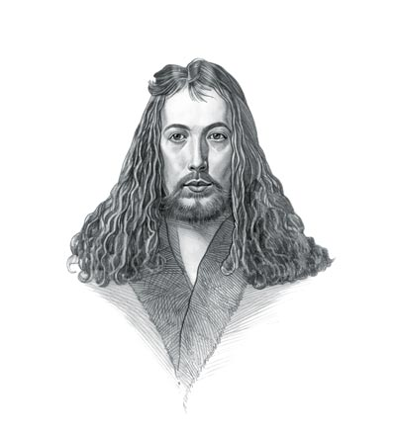
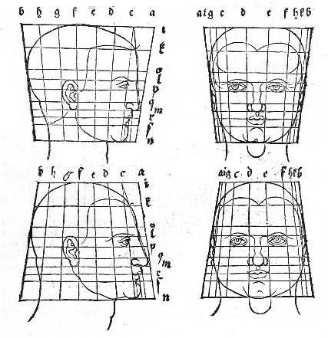
Albrecht Dürer (1471-1528)
Painter, printmaker and theorist
Founder of descriptive geometry working on helices, conchoids and epicycloids
Investigated the Delian Problem (doubling the cube)
Use of shape transformations in studying morphological differences in the human head
Dürer, A. (1528). De Symetria Partium in Rectis Formis Humanorum Corporum Libri, German edn. Patav. Nuremberg: Parisiis Curvi ac recti proportio.

Slide 14
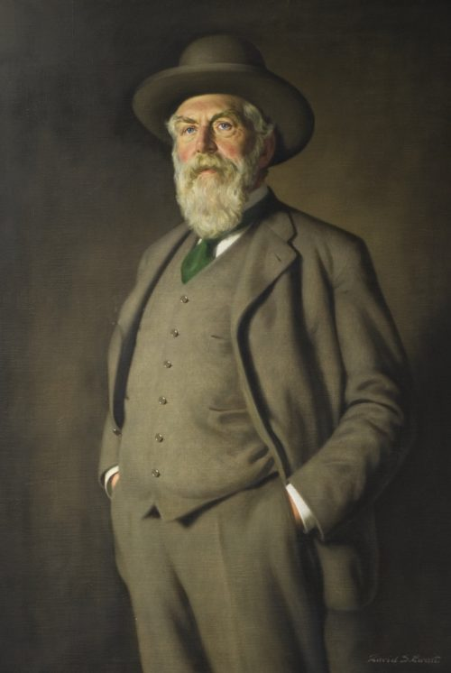
Sir D’Arcy Wentworth Thompson (1860-1948)
Biologist, mathematician and classics scholar
Famous for his quotes on the mathematical beauty of nature (inspiring Huxley, Turing, Lévi-Strauss and van der Rohe)
On Growth and Form (1917)
Fundamental book documenting the process of body structures formed in plants and animals
Emphasis on mathematical structures accounting for biological diversity

Slide 15
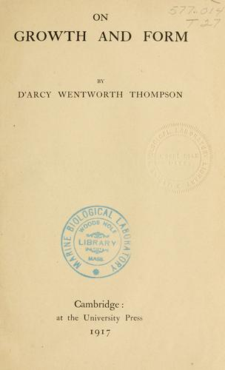
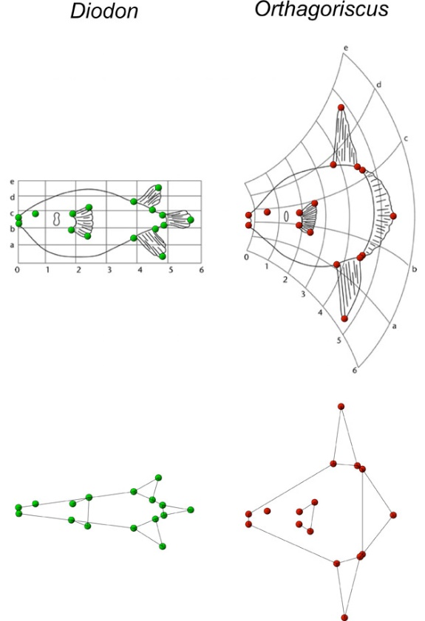
“The harmony of the world is made manifest in Form and Number, and the heart and soul and all the poetry of Natural Philosophy are embodied in the concept of mathematical beauty.”
Thompson, D.W. (1917). On Growth and Form. Cambridge University Press.

Slide 16
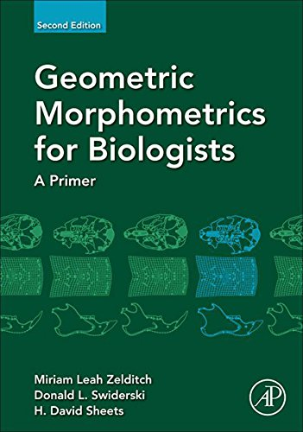
Towards a statistical framework
From the 1960s onwards...
Fred Bookstein (founder of modern-day GMM)
Dennis Slice
Miriam Zelditch
Norman MacLeod
Ian Dryden and Kanti Mardia
James Rohlf

Slide 17

How do we ‘do’ GMM?

Slide 18
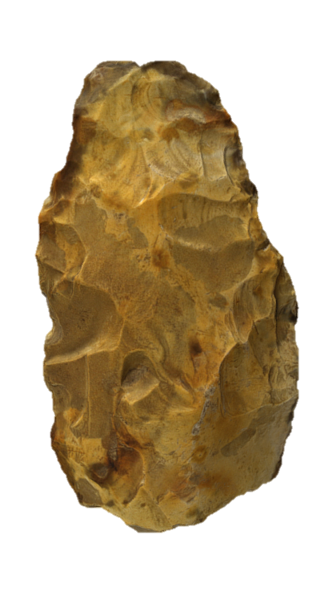
Stage 1: Dataset creation
Methods include…
CT scanning
Photogrammetry and structure from motion (SfM)
Microphotogrammetry
Microscribe
3D scanners (e.g. NextEngine)
Data obtained from drawings and photographs
Note: Considered the error associated with each technique!

Slide 19
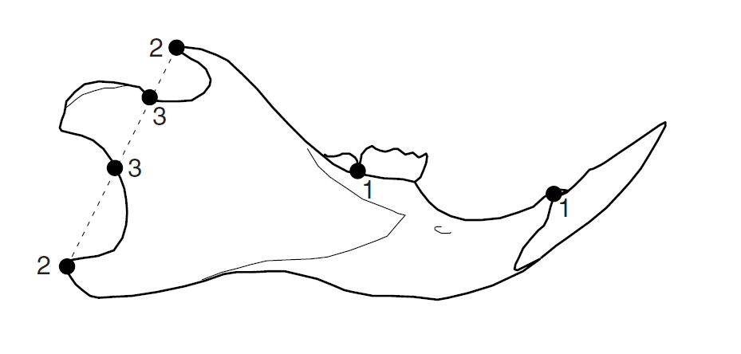
Stage 2: Landmark choice
Central to geometric morphometrics are landmarks
Landmark: coordinate point used to represent a shape and/or a homologous point on a structure
Quantifiable as Cartesian coordinates (x , y / z coordinates)
Variety of different ways of approaching what type of landmarks are necessary
Can be treated as individual points or converted (using various techniques) into curves and outlines
Claude, J. (2008). Morphometrics with R. Springer Publishing.

Slide 20
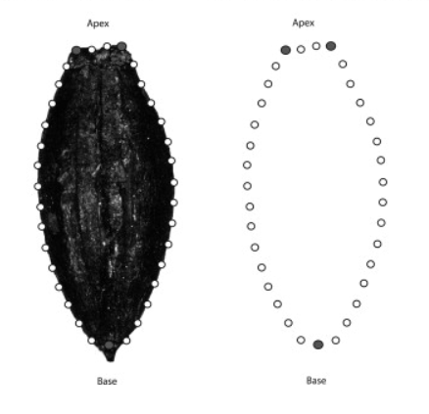
Stage 2: Landmark choice
Various types of landmarks
Type I: Homologous biological structures
Type II: Geometric definition e.g. greatest curvature
Type III: Point with reference to another point
A special example: semilandmarks
Placed using an algorithm
Equidistant and placed between one or two end-points
A special Type III landmark
See also sliding semilandmarks
Claude, J. (2008). Morphometrics with R. Springer Publishing.
Ros, J., Evin, A., Bouby, L. & Marie-Pierre, R. (2013). Geometric morphometric analysis of grain shape and the identification of two-rowed barley (Hordeum vulgare subsp. distichum L.) in southern France. Journal of Archaeological Science. 41.

Slide 21
Stage 2: Landmark choice
Landmarks should sample aspects which are of archaeological interest
Landmarks should be repeatable and identifiable on all examples (if possible)
Landmarks should cover as much of the shape as possible
Sufficient as to not increase the ‘weighting of areas’
Landmarks should always be plotted in the same order (otherwise the math wouldn’t work!)
Claude, J. (2008). Morphometrics with R. Springer Publishing.
Ros, J., Evin, A., Bouby, L. & Marie-Pierre, R. (2013). Geometric morphometric analysis of grain shape and the identification of two-rowed barley (Hordeum vulgare subsp. distichum L.) in southern France. Journal of Archaeological Science. 41.

Slide 22
Stage 2: Landmark choice (some observations)
For Bioarchaeologists…
Greater number of points of morphological correspondence on specimens
Easier to study three-dimensional shape (orientation is less of an issue)
For Archaeologists studying non-biological material…
Greater creativity and thought is needed in orienting specimens and placing landmarks
Fewer case studies to compare geometric morphometric methodologies
For all archaeologists…
Fragmentation and sample size (representation of a population) need to be considered

Slide 23
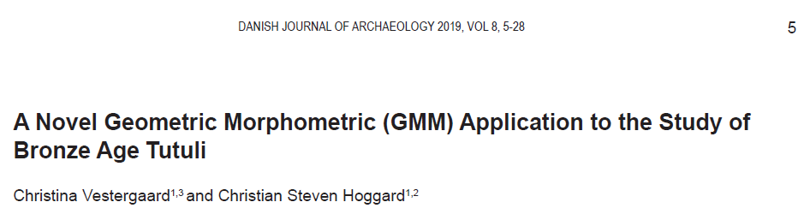

Slide 25
Stage 3: Landmark digitisation
Variety of different programs including:
TPS Suite (TpsUtil and TpsDig2)
R Packages (geomorph, StereoMorph, shape and GUImorph)
Landmark Editor (IDAV)
SlicerMorph
PhyloNimbus
Variety of different output files created including:
.tps*
.nts
.csv
.txt

Slide 26

GMM in the R Environment
With an increasing number of packages for creating, manipulating and analysing shape coordinates, and a more code-literate discipline, R is the ideal environment for archaeologists.
Permits a transparent, repeatable and reproducible GMM workflow.
Note: you may find certain stages easier to process outside of the R environment e.g. digitisation (and that is fine!)

Slide 27
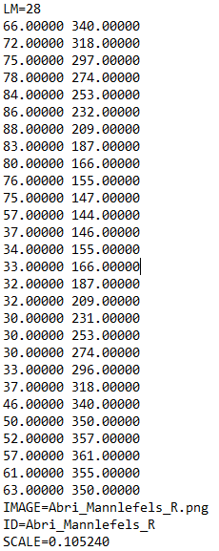
Stage 3: Landmark digitisation
Ask yourself…
Do all my specimens have the correct number of points?
Are all my landmarks in the correct order?
Are the ID labels correct?
Are they to scale? (For size-integrated analyses)
An example of a .tps file

Slide 28
Different forms of shape analysis
Landmark Analysis
Outline Analysis
Semi-landmark Analysis
Fourier-based Analysis
Radial Fourier Analysis (RFA)
Elliptic Fourier Analysis (EFA)
Discrete Cosine Transform (DCT)
Eigenshape Analysis
Other methods e.g. Polynomial Curve Fitting
Workshop Two!

Slide 29
Generalised Procrustes Analysis (GPA)
Also known as…
Procrustes Superimposition
Procrustes Analysis
Procrustes Fitting
Generalised Least Squares
Procedure to isolate shape from a number of sometimes related variables, specifically rotation, size and translation

Slide 30
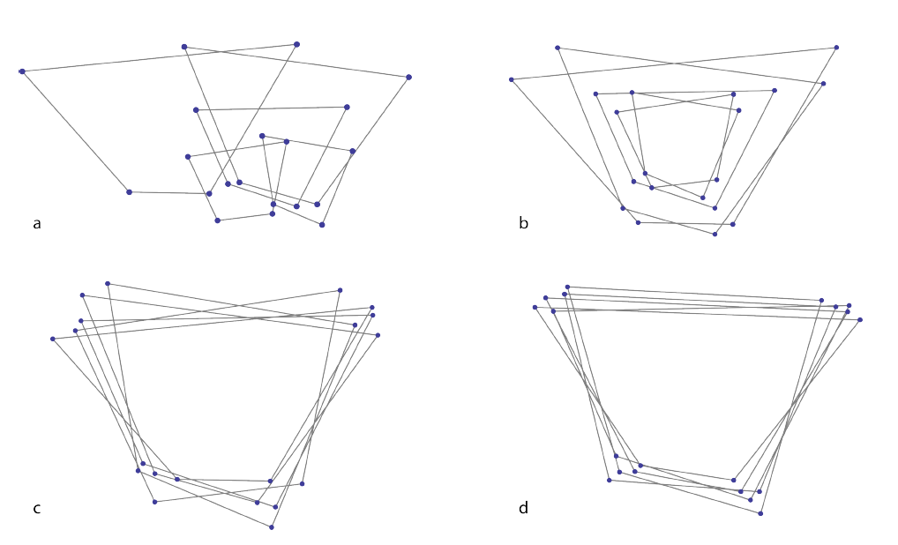
Generalised Procrustes Analysis (GPA)
The raw coordinates are…
Translated to a common centroid (A-B)
Scaled to the same centroid size (B-C)
Rotated to minimise the summed square distances between landmarks (C-D)
Outcome: Procrustes coordinates
The Procrustes coordinates = shape per se
Mitteroecker, P., Gunz, P., Windhager, S. & Schaefer, K. (2013). A brief review of shape, form, and allometry in geometric morphometrics, with applications to human facial morphology. Hysterix, the Italian Journal of Mammalogy. pp. 59-66.

Slide 31
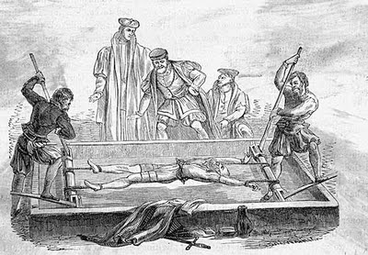
Who was Procrustes?
In Greek Mythology…
Procrustes was a son of Poseidon and lived on a sacred way between Athens and Eleusis.
There he had a bed, in which he invited every passer-by to spend the night, and where he set to work on them with his blacksmith's hammer, to stretch them to fit.
In later tellings, if the guest proved too tall, Procrustes would amputate the excess length; nobody ever fitted the bed exactly.
Procrustes continued his reign of terror until he was captured by Theseus, travelling to Athens along the sacred way, who "fitted" Procrustes to his own bed!

Slide 32
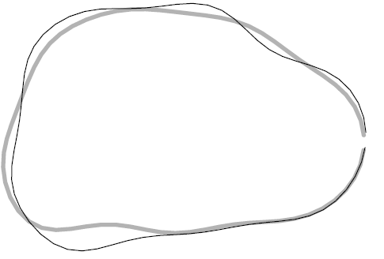
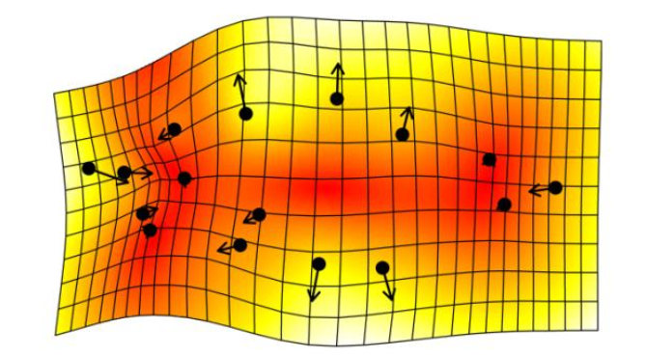
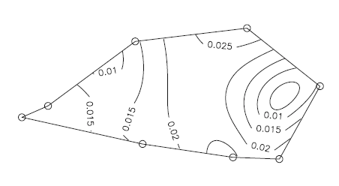
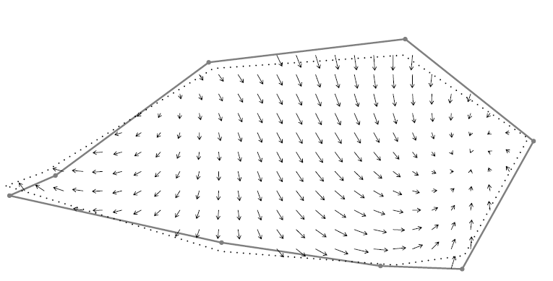
What can we do with these coordinates? #1: Visualising shape change
Represent shape change as…
Deformation grids
Principal strains
Lollipop sticks
Vectors
Contours
Claude, J. (2008). Morphometrics with R. Springer Publishing.

Slide 33
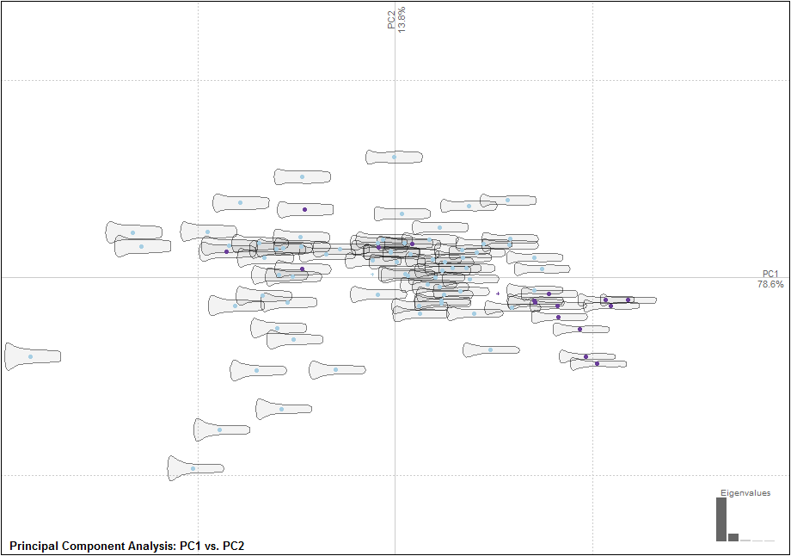
What can we do with these coordinates? #2: Explore differences in shape through a PCA
PCA = Principal Component Analysis
Often the first method of analysis
Every point = landmark configuration
Mean shape = axis origin
Principal axes = sources of theoretical shape change
The scores produced are often used for further analysis
Hoggard, C.S., Lauridsen, L. and Witte, K.B. (2019). The Potential of Geometric Morphometrics for Danish Archaeology: Two Case Studies. Arkæologisk Forum, 40: 30-42. (http://www.archaeology.dk/16738/Nr.%2040%20-%202019). OSF: https://osf.io/en5d2/

Slide 34
What can we do with these coordinates? #3: Explore group differences through DA
DA = Discriminant Analysis (or Canonical Variate Analysis)
Examine the success with which a priori classifications can be distinguished through maximum-group separation.
Landmark configuration vs. PCA scores.
Creation of a training dataset to test unknown knowns.
Initial percentage = separation success on group data
Jack-knifed percentage (leave-one-out cross validation)
Determines success with which an artefact can be categorised solely on its shape
Vestergaard, C. and Hoggard, C.S. (2019). A Novel Geometric Morphometric (GMM) Application to the Study of Bronze Age Tutuli. Danish Journal of Archaeology, 8: 5-28.

Slide 35
What can we do with these coordinates? #4: Conduct a Procrustes ANOVA / MANOVA (statistical exercise)
PCA and DA act as exploratory devices for looking at shape difference
MANOVA and Procrustes ANOVA provide a statistical framework for examining shape
Procrustes ANOVA: performed in Geomorph (with landmark data)
MANOVA: performed in Momocs (with landmark and outline data)
Null hypothesis: same populations / shape

Slide 36
What can we do with these coordinates? #5: Perform correlation and regression analyses
Useful for examining shape hypotheses involving quantitative data for example size.
Other possible variables:
Symmetry
Latitude
Response (logistic regression)
PCA scores can be fed in using the base::lm() function.
Hoggard, C.S., McNabb, J. and Cole, J.N. (2019). The application of elliptic Fourier analysis in understanding biface shape and symmetry through the British Acheulean. Journal of Paleolithic Archaeology, 2 (2): 115-133,

Slide 37
What can we do with these coordinates? #6: Perform cluster-based analyses
A useful method for examining a posteriori classifications.
Utilises Principal Component scores (generated from the PCA!)
A variety of different cluster analyses are available.
Momocs: Hierarchical Clustering
Rphylip: Parsimony / Maximum Likelihood (computationally intensive!)
Ivanovaite, L., Serwatka, K., Hoggard, C.S., Sauer, F. and Riede, F. (2012). All these fantastic cultures? Research history and regionalisation in the Late Palaeolithic tanged point cultures of Eastern Europe. European Journal of Archaeology.

Slide 39
A quick note on outline-based analyses
Useful for when homologous landmarks are difficult to place on a structure e.g. handaxes.
Advantages over landmark analysis (for certain outline methods):
Do not need the same amount of points for each artefact (many more will be necessary for more complex objects).
Do not need to start at exactly the same position.
One of the main outline-based methodologies: Elliptic Fourier Analysis (EFA):
Semilandmarks are fed through a series of parametric equations (grounded on sine and cosine functions) to produce coefficients which create curve.
Coefficients are examined similarly to the Procrustes Coordinates
Workshop 2: R Demonstration (through Elliptic Fourier Analysis)

Slide 40
Concluding Remarks: Future Directions
Greater application of GMM in a variety of new (non biological) archaeologies
Methodological applications: automisation (recording and landmarking)
Coding developments: towards a replicable, reproducible and Shiny GMM…
More powerful analytics: e.g. Bayesian and Machine Learning techniques

Slide 41
Thank you for attending!

